Slide 1


Slide 2
What is Feature Engineering ?
Why ?
When ? .
…….?

Slide 3
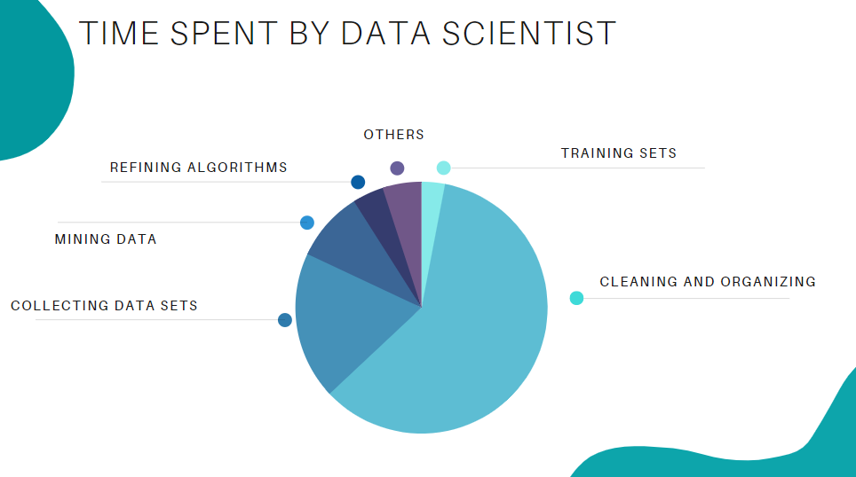

Slide 4
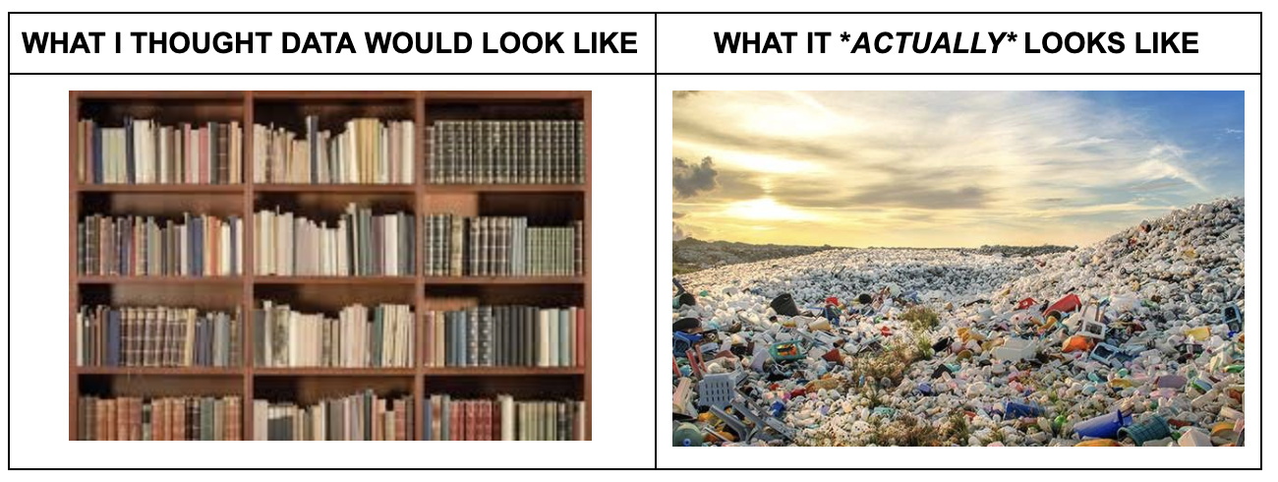

Clean Data
ML Model

Slide 5
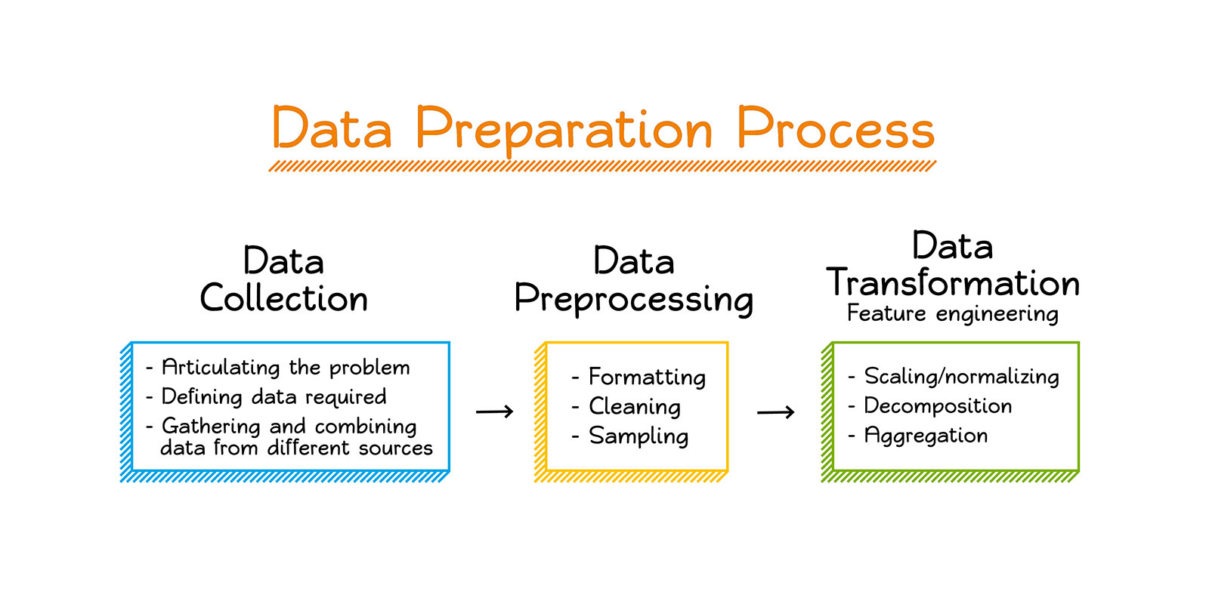

Slide 6
Feature Engineering
The goal of simplifying and speeding up data transformations while also enhancing model accuracy

Slide 7


Slide 8
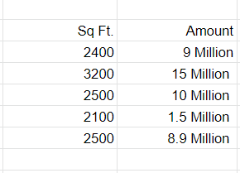
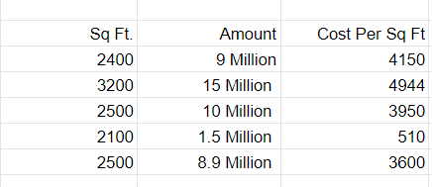
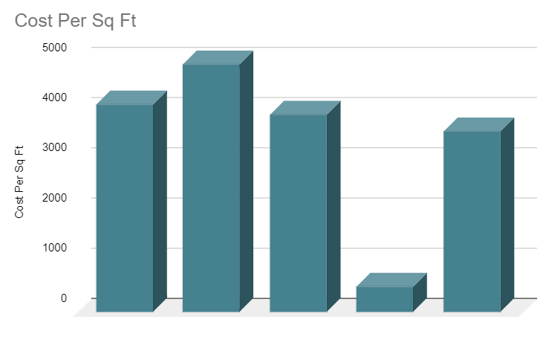

Slide 9

Domain Knowledge
Visualization
Statistic

Slide 10

Feature Engineering Techniques for Machine Learning
Imputation
Handling Outliers
Log Transform
Encoding
Scaling

Slide 11
Feature Engineering is a process of Extracting useful feature from raw data using Math , Visualization and Domain Knowledge

